Slide 1

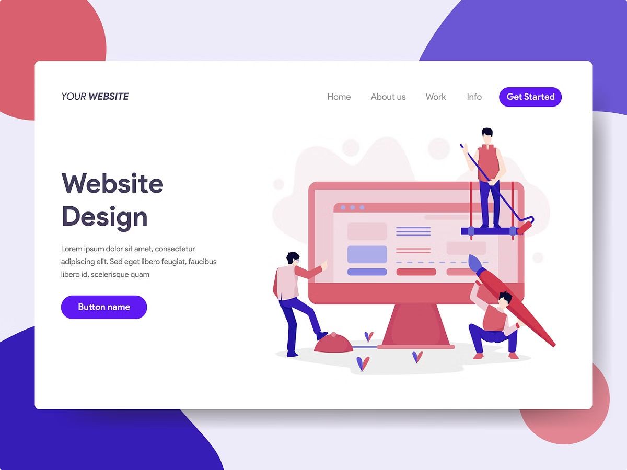
Education Blog Website
Explore the features and team collaboration that power our dynamic education blog website.

Slide 2

Meet the Team
Sharjeel
Hannef
Sanaullah
Hasnain
Interface Design
Create Post Feature
Create Post Feature
Add Comments Feature

Slide 3

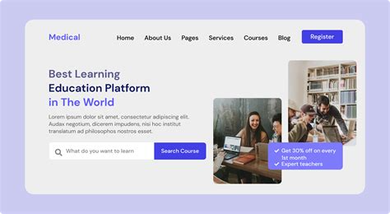
Key Features
Create Post
Share Post
Add Comments

Slide 4

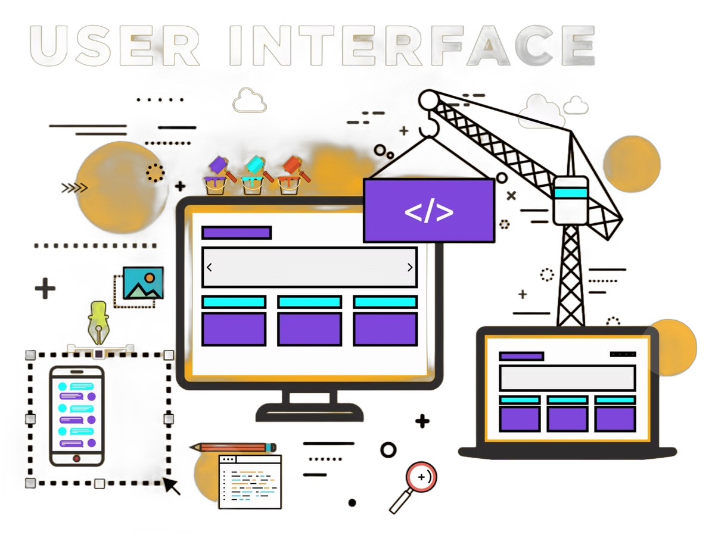


Sharjeel: Interface Design
Responsive
Tailored for desktop
Visually Appealing
Engaging and on-brand visuals
Intuitive UX
Easy navigation and content access

Slide 5

Hannef & Sanaullah: Create Post
1
Organize Content
Intuitive editor for structuring posts
2
Media Integration
Seamlessly add your ideas in the post
3
Publish and Share
One-click publishing and social sharing

Slide 6





Hasnain: Comments Feature
1
Reader Engagement
2
Encourage Discussion
3
Enable Feedback
4
Improve Content
5
Build Community

Slide 7
The Journey: A Collaborative Success
Initial Stages
1
The team began by defining the project scope and objectives, ensuring everyone was aligned on the overall vision. Each member contributed their expertise to develop a comprehensive plan, outlining individual responsibilities and milestones.
2
Development Phase
During the development phase, consistent communication and collaboration were key. Regular meetings, progress updates, and feedback sessions facilitated a smooth workflow. The team effectively leveraged each member's strengths, addressing challenges collectively and ensuring the project stayed on track.
Testing and Refinement
3
Rigorous testing and refinement were integral to the journey. The team meticulously reviewed the project, identifying areas for improvement and implementing necessary adjustments. This iterative process ensured a high-quality outcome that met the initial objectives.
4
Final Outcome and Celebration
The collaborative efforts culminated in a successful project delivery. The team celebrated their achievements, acknowledging the contributions of each member. The shared journey fostered a sense of accomplishment and strengthened team cohesion.

